Slide 1
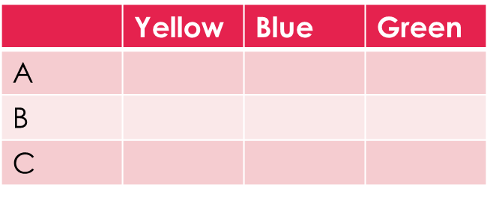
Topic: Tree Diagrams EQ: How can we show two –step problems with tree diagrams?
Review questions (on LHS)
There is a bag with 3 marbles (yellow, blue, green) and 3 pieces of paper with letters (A, B, C). Complete the two way table:
P(yellow and A) =
P(complement of Blue) or P(B’) =
P(C) =
Steps to be successful this lesson:
Get materials out (notebook, pen, pencil, ruler, calculator)
Rule up notebook and write Topic and EQ
Start on review questions →
Check your answers with someone sitting next to you
Is your notebook up to date? (Contents page, glossary, review notes etc.)

Slide 2
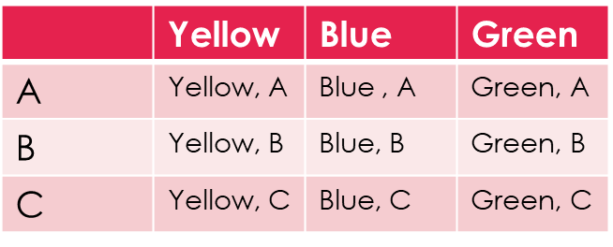
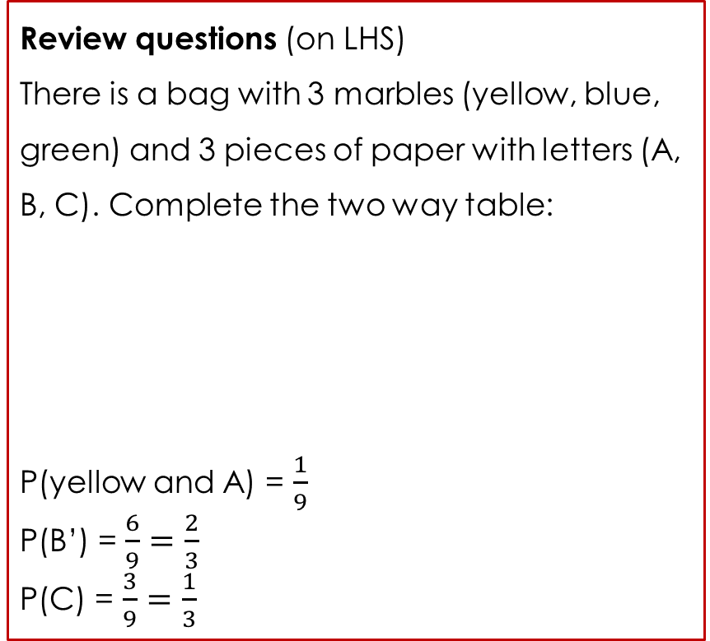
Topic: Tree Diagrams EQ: How can we show two –step problems with tree diagrams?
Review questions (on LHS)
There is a bag with 3 marbles (yellow, blue, green) and 3 pieces of paper with letters (A, B, C). Complete the two way table:
P(yellow and A) = $\frac{1}{9}$
P(B’) = $\frac{6}{9}=\frac{2}{3}$
P(C) = $\frac{3}{9}=\frac{1}{3}$
Steps to be successful this lesson:
Get materials out (notebook, pen, pencil, ruler, calculator)
Rule up notebook and write Topic and EQ
Start on review questions →
Check your answers with someone sitting next to you
Is your notebook up to date? (Contents page, glossary, review notes etc.)

Slide 3
Tree Diagrams Probability Lesson 3
Year 9

Slide 4
24
7
30
Topic: Tree Diagrams
Date:
EQ – How can we show two step problems with tree diagrams?
What is a tree diagram?
Tree diagrams are another useful way of creating representations of multi step events. Each outcome is represented on a “branch”
For a coin toss we can have a heads or a tails. What happens if we toss two coins?

Slide 5
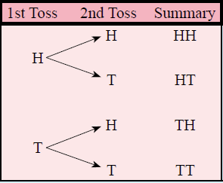

24
7
30
Topic: Tree Diagrams
Date:
EQ – How can we show two step problems with tree diagrams?
What is a tree diagram?
Tree diagrams are another useful way of creating representations of multi step events. Each outcome is represented on a “branch”
For a coin toss we can have a heads or a tails. What happens if we toss two coins?

Slide 6
24
7
30
Topic: Tree Diagrams
Date:
EQ – How can we show two step problems with tree diagrams?
What is a tree diagram?
Tree diagrams are another useful way of creating representations of multi step events. Each outcome is represented on a “branch”
For a coin toss we can have a heads or a tails. What happens if we toss two coins?

Slide 7
24
7
30
Topic: Tree Diagrams
Date:
EQ – How can we show two step problems with tree diagrams?
What is a tree diagram?
Tree diagrams are another useful way of creating representations of multi step events. Each outcome is represented on a “branch”
For a coin toss we can have a heads or a tails. What happens if we toss two coins?
4 outcomes
Heads then Heads = 0.25
Heads then Tails = 0.25
Tails then Heads = 0.25
Tails then Tails = 0.25
What is the probability of getting one of these outcomes?

Slide 8


Slide 9
Activity
You will be given a spot to stand in the room
You need to work out why you are standing there
Notes:
Dark hair, not dark hair
Short hair, long hair
Alternatives: boy / girl, shorts/pants

Slide 10
Short hair
Long hair
5

Slide 11
Light hair
Short and Light hair
Short hair
Dark hair
Short and Dark hair
Light hair
Long and Light hair
Long hair
Dark hair
Long and Dark hair
5

Slide 12
Light hair
Short and Light hair
Short hair
Dark hair
Short and Dark hair
Light hair
Long and Light hair
Long hair
Dark hair
Long and Dark hair
5

Slide 13




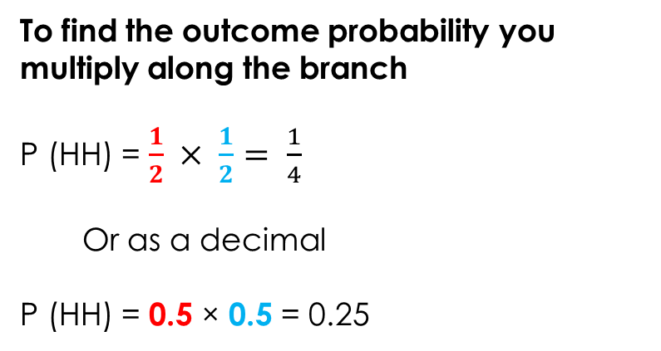


24
7
30
Topic: Tree Diagrams
Date:
EQ – How can we show two step problems with tree diagrams?
Using the same example as before:
What was the probability of getting heads or tails for the first toss?
We know these are the 4 outcomes
Heads then Heads = 0.25
Heads then Tails = 0.25
Tails then Heads = 0.25
Tails then Tails = 0.25
How do you calculate the probability from a tree diagram?
What was the probability of getting heads or tails for the second toss?
$$\frac{1}{2}$$
To find the outcome probability you multiply along the branch
P (HH) = $\frac{1}{2} × \frac{1}{2}= \frac{1}{4}$
Or as a decimal
P (HH) = 0.5 × 0.5 = 0.25
$$\frac{1}{2}$$
$$\frac{1}{2}$$
$$\frac{1}{2}$$
$$\frac{1}{2}$$
$$\frac{1}{2}$$

Slide 15
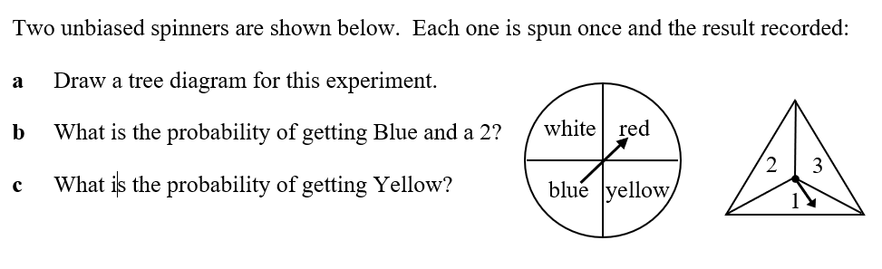






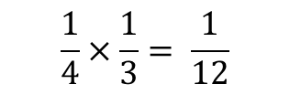



Worked Example
White
Red
Blue
Yellow
1
2
3
1
2
3
1
2
3
1
2
3
$$\frac{1}{4}$$
$$\frac{1}{4}$$
$$\frac{1}{4}$$
$$\frac{1}{4}$$
$$\frac{1}{3}$$
$$\frac{1}{3}$$
$$\frac{1}{3}$$
$$\frac{1}{3}$$
$$\frac{1}{3}$$
$$\frac{1}{3}$$
$$\frac{1}{3}$$
$$\frac{1}{3}$$
$$\frac{1}{3}$$
$$\frac{1}{3}$$
$$\frac{1}{3}$$
$$\frac{1}{3}$$
$$\frac{1}{4}×\frac{1}{3}= \frac{1}{12}$$
P (Blue and 2) =
P(Yellow) =
$$\frac{1}{4}$$

Slide 16
